Slide 1
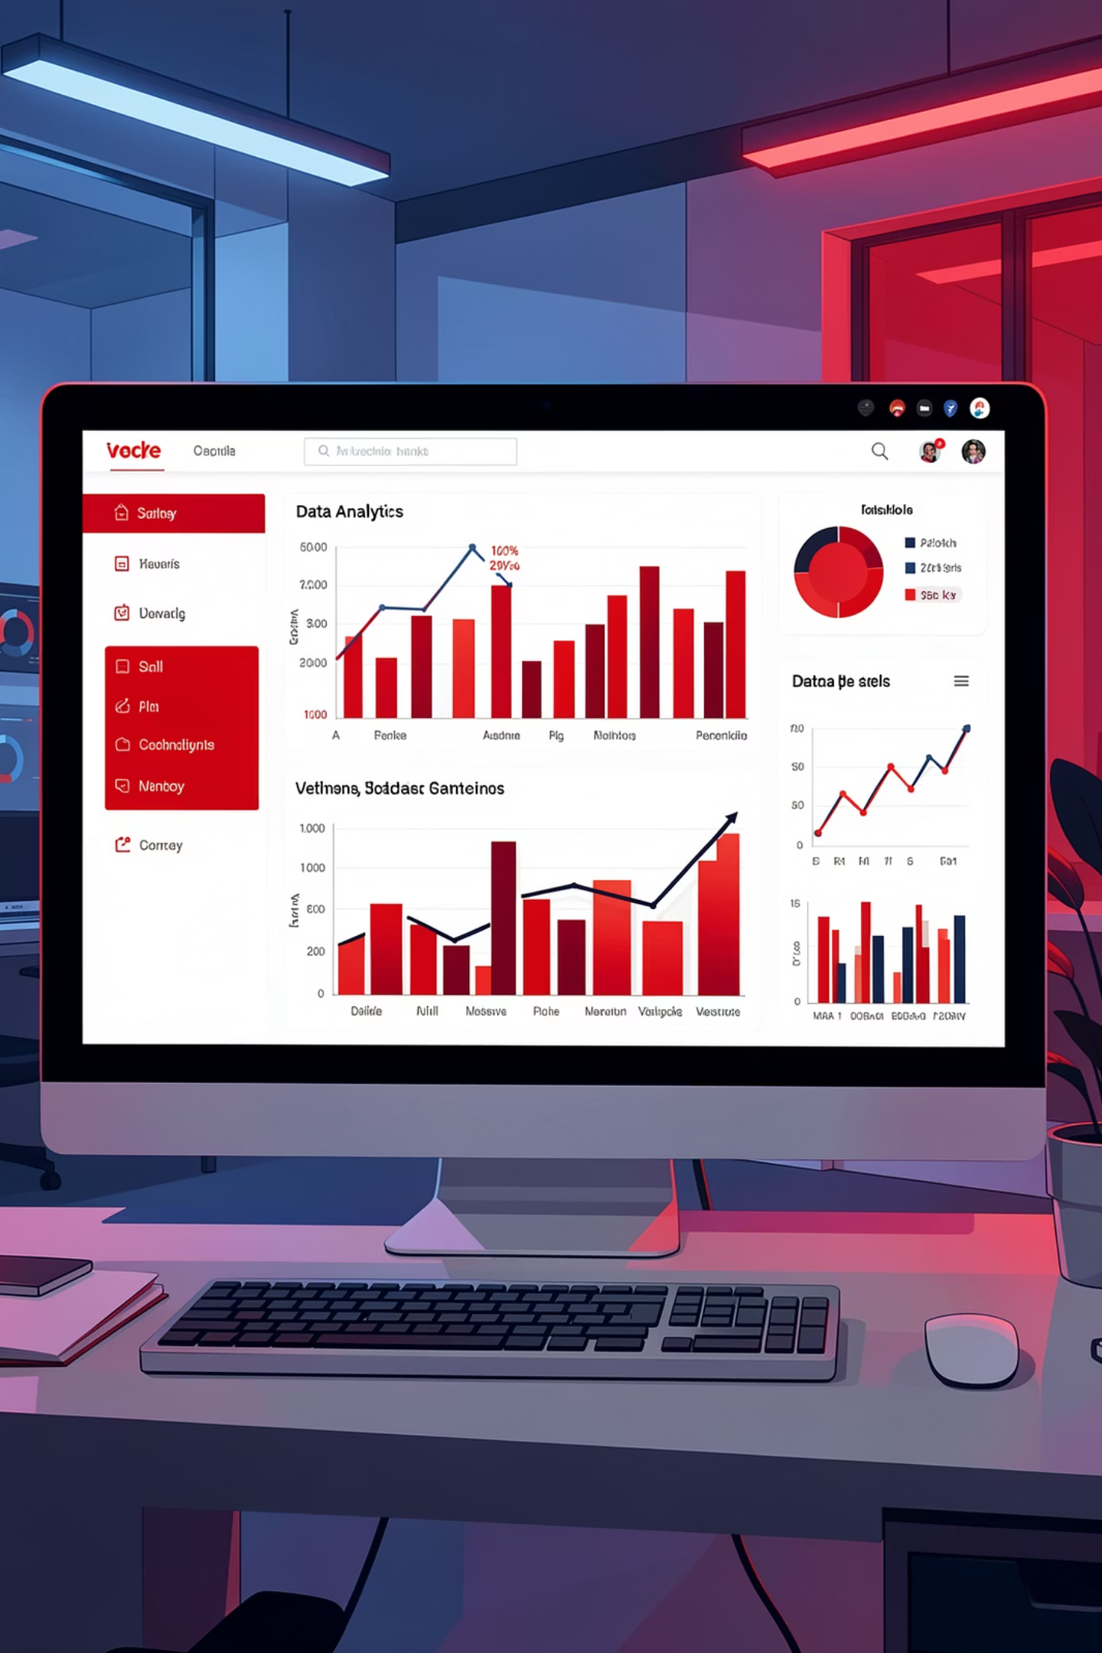
Customer Order Summary Analysis
An end-to-end data analytics project demonstrating the complete workflow from data preprocessing in Python to SQL analysis and interactive Power BI visualization.

Slide 2

PROJECT GOALS
Driving Business Intelligence
Revenue Performance
Profit Analysis
Track and analyze revenue streams across channels and regions.
Identify profit drivers and optimize margins across product lines.
Regional Distribution
Channel Performance
Understand geographic sales patterns and opportunities.
Compare effectiveness of retail, online, and distributor channels.

Slide 3
Dataset Overview
330
17
Total Orders
Data Columns
Complete order records analyzed
Comprehensive attributes per order
Each order includes a unique order_id as the primary key, enabling detailed tracking and analysis across multiple dimensions including customer, product, region, and channel.

Slide 4

PYTHON
Data Cleansing & Loading
01
Import Data
Loaded Excel file using Pandas library for initial data exploration.
02
Quality Checks
Used df.info(), df.describe(), and isnull() to identify missing values and data types.
03
Standardize Names
Updated column names with underscores for SQL compatibility.
04
Export to SQL
Installed sqlalchemy and pyodbc to transfer clean data to SQL Server.

Slide 5

SQL ANALYSIS
Structured Query Insights
Executed comprehensive SQL queries on the order_details table to extract actionable business intelligence across revenue, profit, regional performance, and customer behavior patterns.

Slide 6
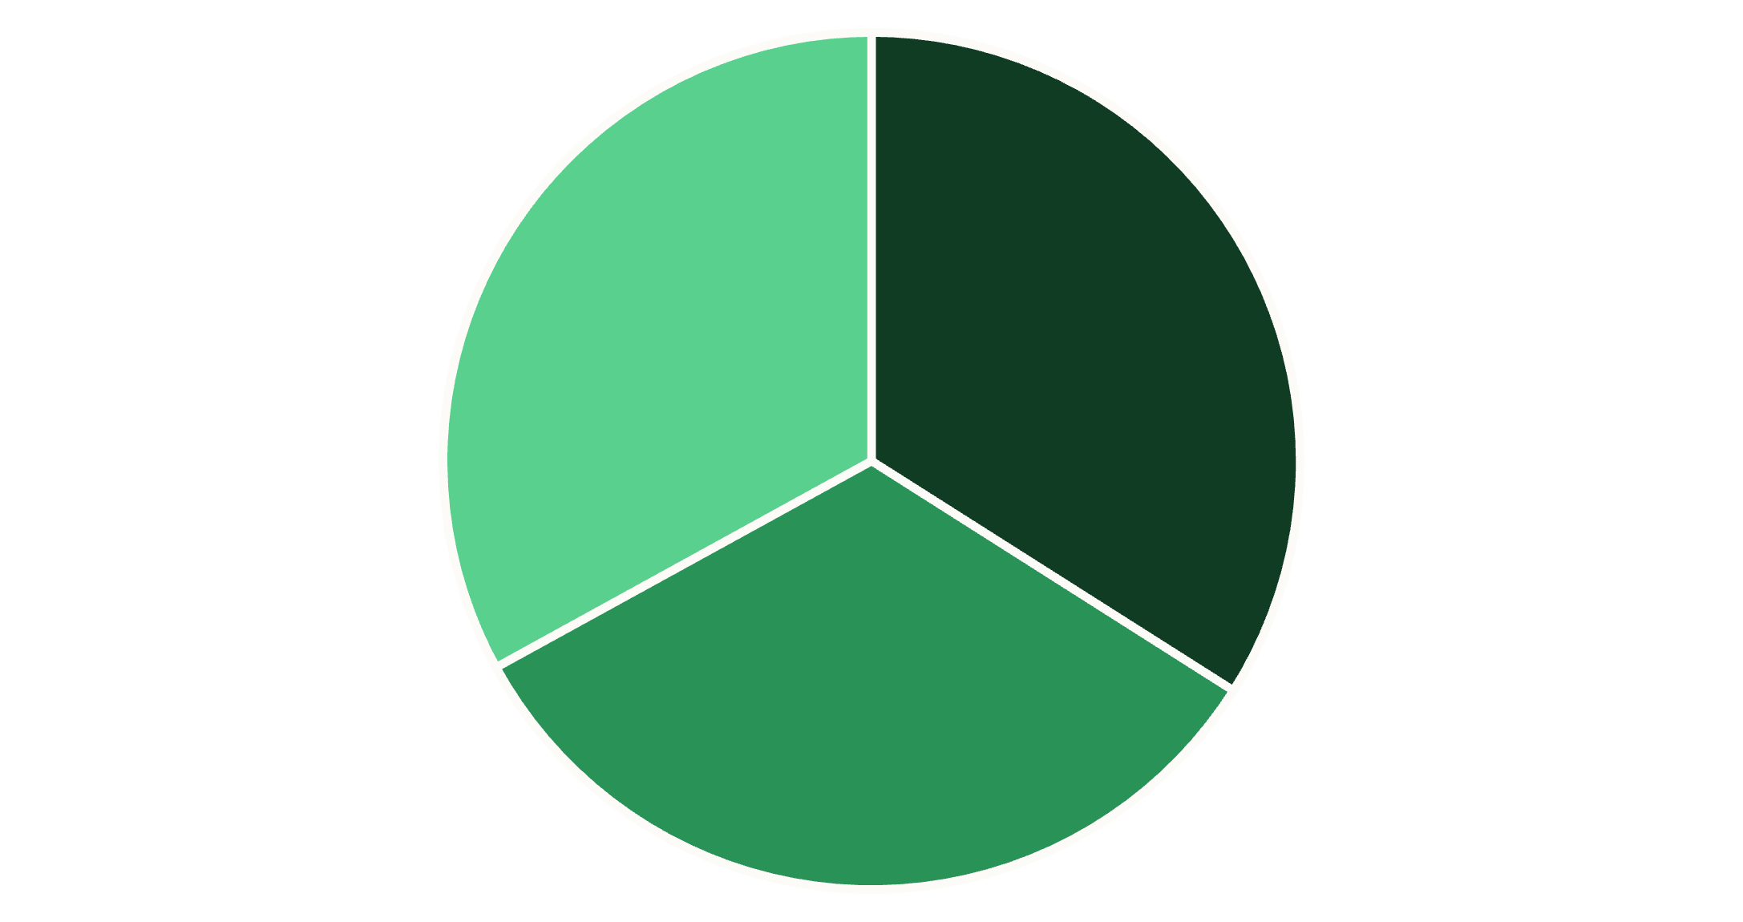
Channel & Regional Performance
Key Findings
Retail stores generate 34% of total revenue and profit
North region drives the highest profits and revenue
UPI payment is the most common method among customers
Making UPI available across all channels could increase sales conversion rates.
Retail Stores
Online
Distributor

Slide 7



Product Profitability Analysis
Keyboard
Mouse
Tablet
Top profit driver with consistent demand across all regions.
Strong profit margins with high sales volume in retail stores.
Premium product generating maximum profit per unit sold.

Slide 8
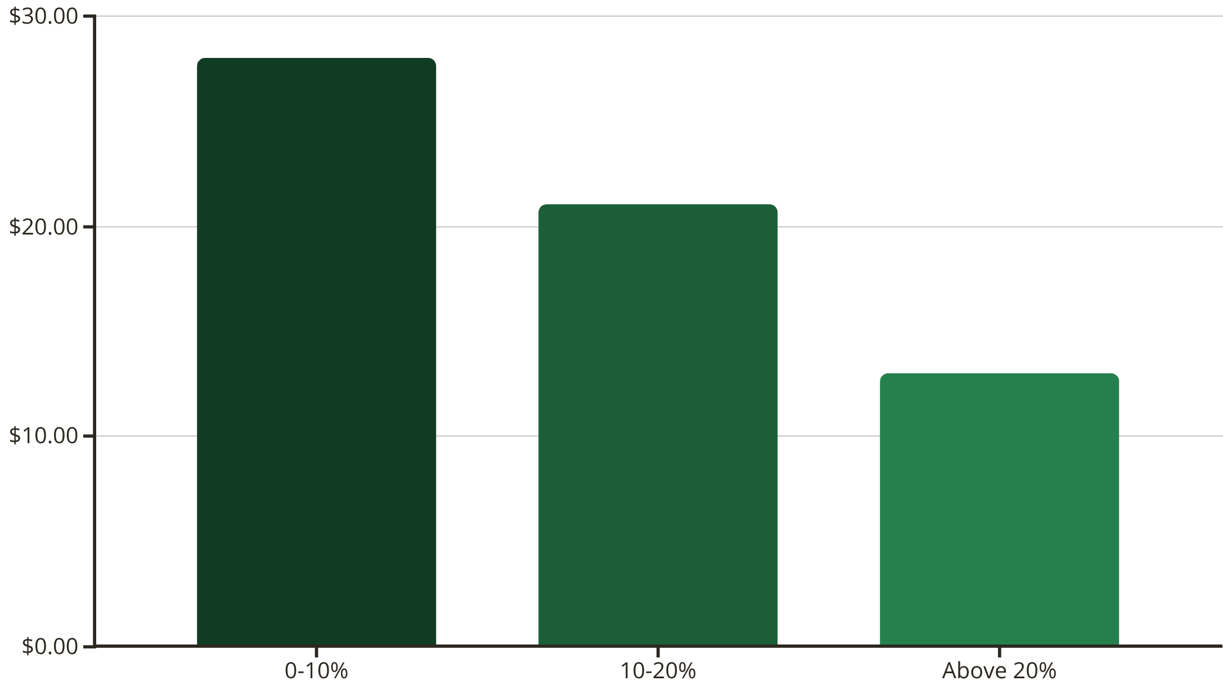

Discount Impact on Profitability
Critical Finding
Average profit margin drops to just 13% when discount rates exceed 20%. Strategic discount management could significantly improve profitability.
Revenue and profit peaked in May, suggesting optimal timing for promotional campaigns. Consider targeted discounts under 20% during high-traffic months.

Slide 9
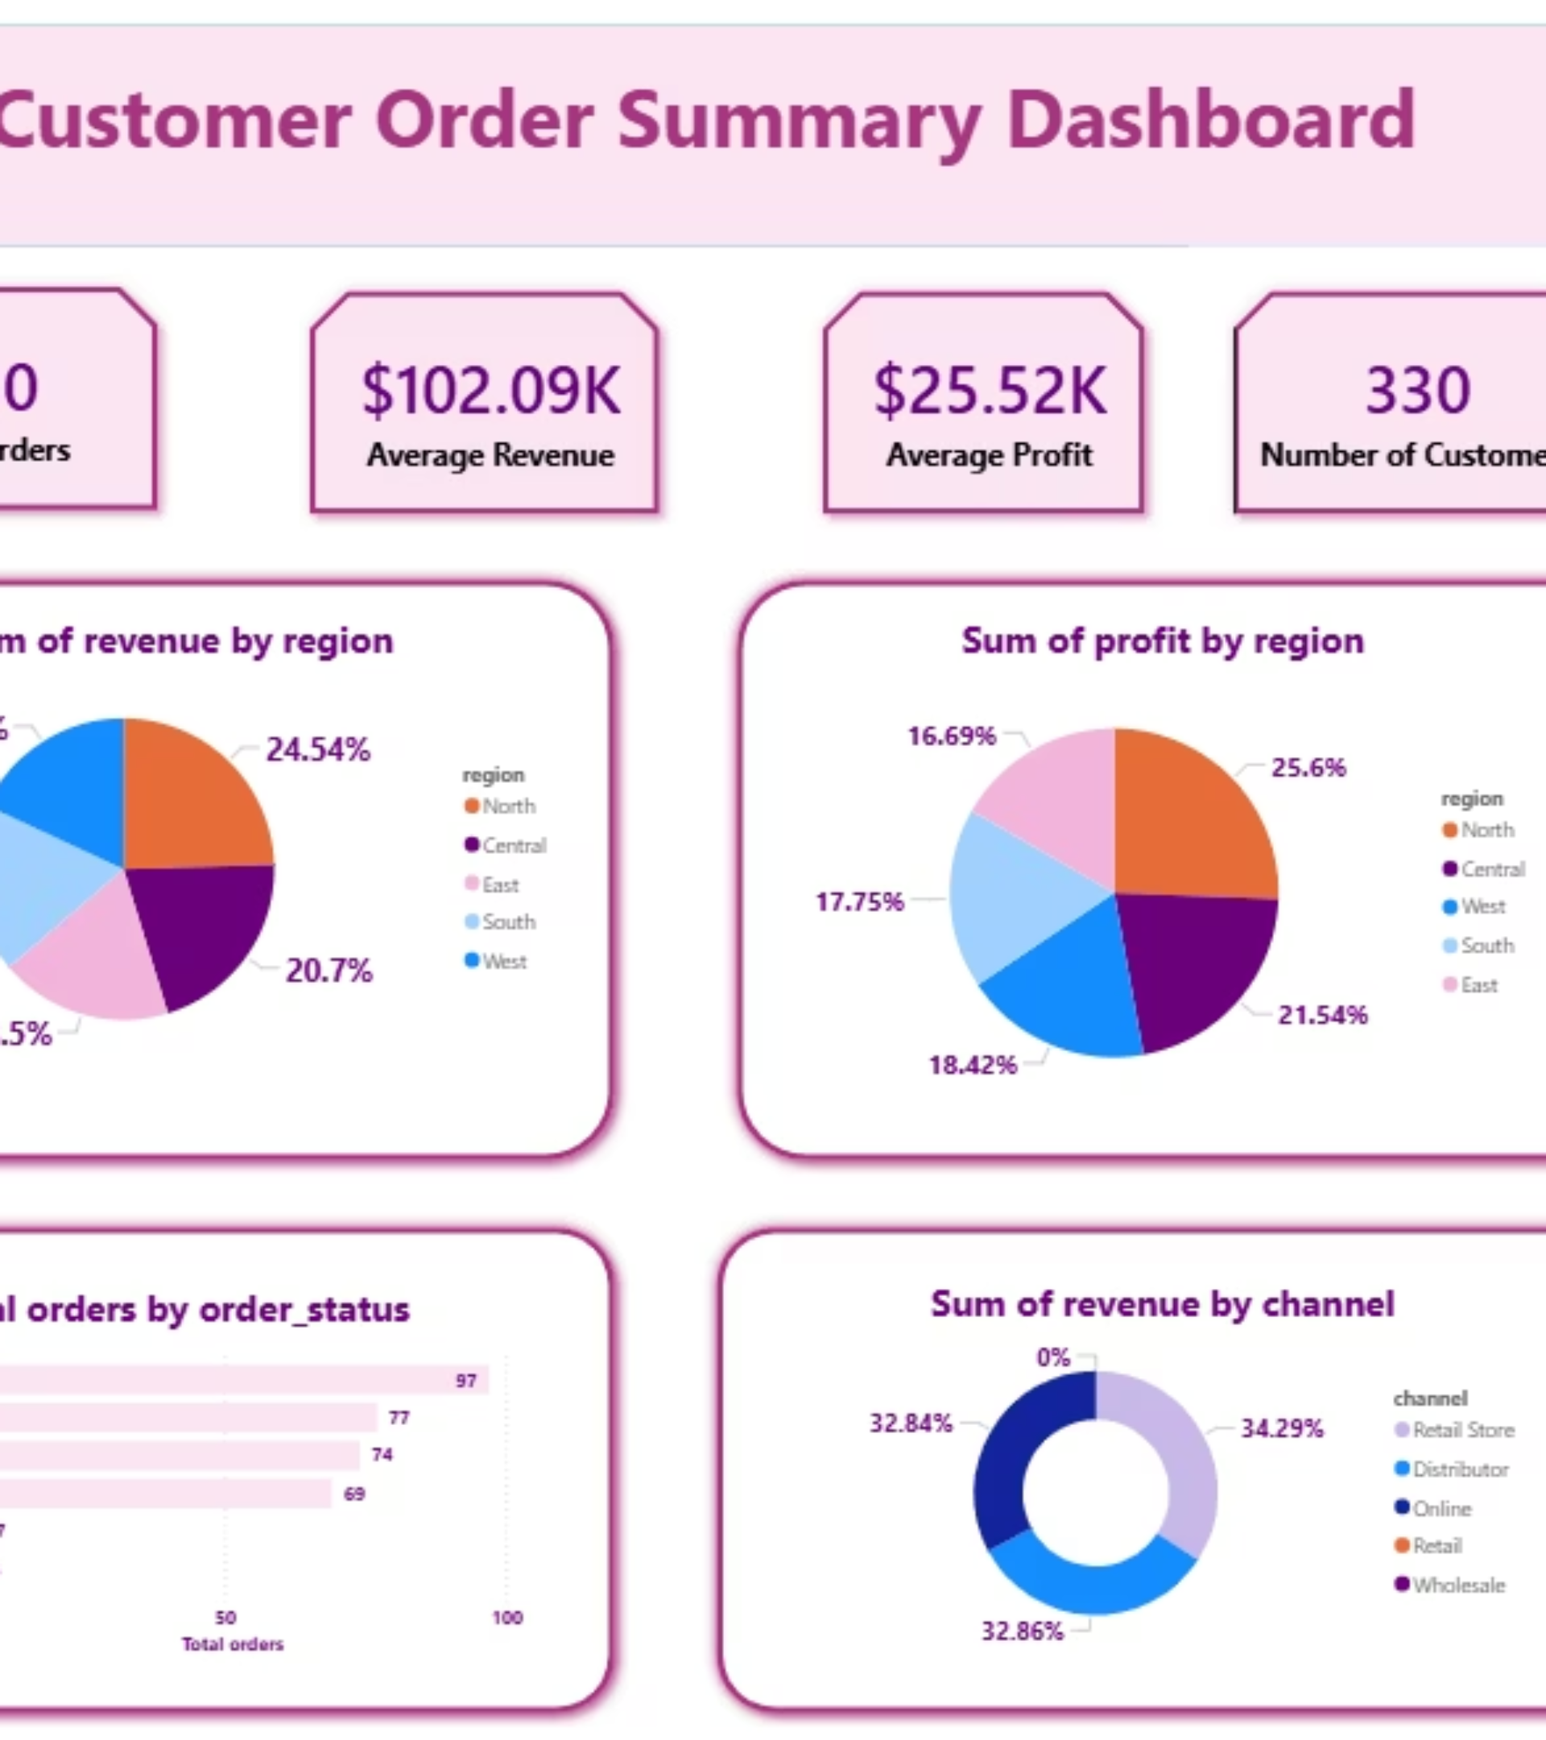
DASHBOARD
Power BI Visualization
Created comprehensive Customer Order Summary Dashboard showcasing revenue and profit metrics by region and channel, enabling real-time business monitoring and data-driven decision making.

Slide 10
Strategic Recommendations
Focus on North Region
Optimize Discount Strategy
Expand UPI Availability
Capitalize on May Peak
Allocate more resources to the highest-performing region to maximize returns.
Keep discounts below 20% to maintain healthy profit margins above 20%.
Make UPI payment universal across all channels to reduce friction.
Launch targeted promotions during high-traffic months to boost revenue.
Prioritize Top Products
Strengthen Retail Channel
Increase inventory and marketing for Keyboard, Mouse, and Tablet.
Invest in retail store experience as it drives 34% of total revenue.

